Slide 1
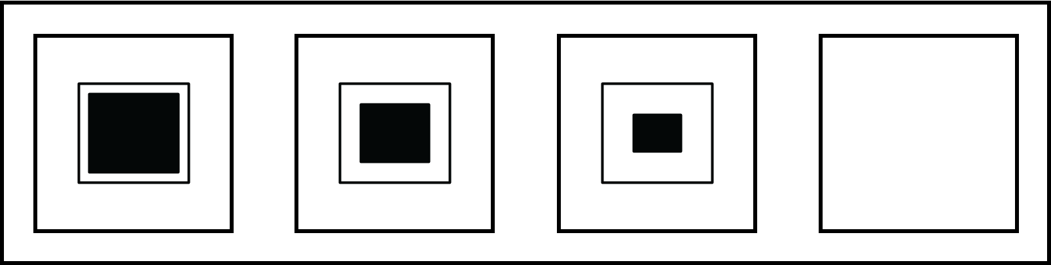
Cognitive Neuroscience of Reasoning
March 30, 2021
Tom Morin

Slide 2
“From a drop of water, a logician could infer the possibility of an Atlantic or a Niagara without having seen or heard of one or the other.”
- Sir Arthur Conan Doyle
Notes:
“It is not enough to have a good mind; the main thing is to use it well.” Descartes
“The last function of reason is to recognize that there are an infinity of things which surpass it.” – Blaise Pascal
“We adore chaos because we love to produce order.” M.C. Escher

Slide 3
What is reasoning?
Hume: An activity of the mind that takes us from the observed to the unobserved.
From the fact that the sun has risen every day thus far, we can conclude that it will rise tomorrow. (Cambridge Handbook of Thinking and Reasoning 2005)
David Hume
Notes:
Hume believed that there is no such thing as innate human knowledge.
All knowledge is derived from experience

Slide 4
Agenda: How Does a Brain Reason?
Types of Reasoning & Common Reasoning Tasks
Brief History of Intelligence Testing
Functional Brain Networks that Support Reasoning
My Research: Reasoning on a Simplified Raven’s Progressive Matrices Task

Slide 5
Inductive vs. Deductive Reasoning
Inductive: Moving from specific evidence to a broad theory
Deductive: Testing an existing theory with specific observations

Slide 6
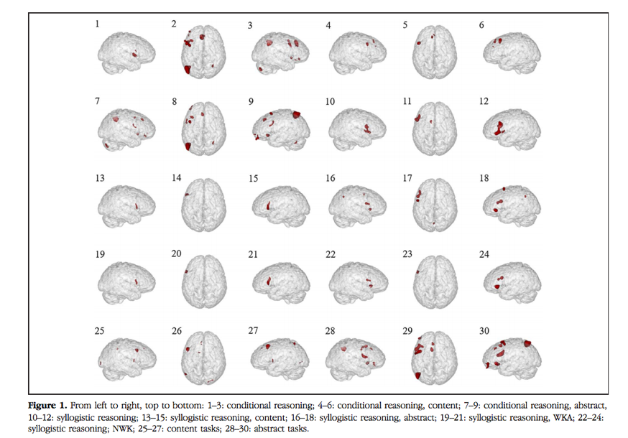
Syllogisms
Logical Argument applying deductive reasoning
Arrive at a conclusion based on two or more arguments assumed to be true.
Meta-analysis: Wertheim & Ragni 2020
Notes:
Syllogisms are pretty complex... there's a lot going on... we have statements to be evaluated and compared... rules to derive, etc.

Slide 7
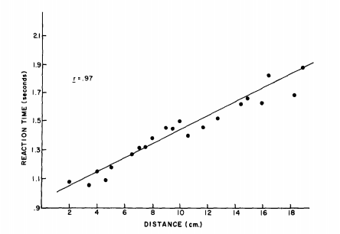
Spatial Reasoning (Mental Scanning)
Mental scanning between two objects on a fictional map increases as the distance between them increases
Kosslyn, Ball, & Rieser 1978

Slide 8
Mental Rotation & Object Detection
Schendan & Stern 2007

Slide 9
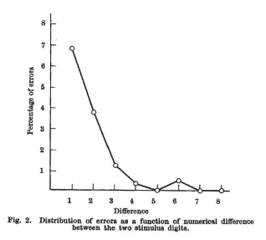
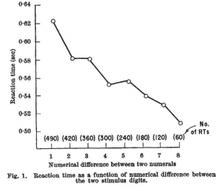
Symbolic Distance Effect
Moyer & Landauer 1967 (Nature)

Slide 10
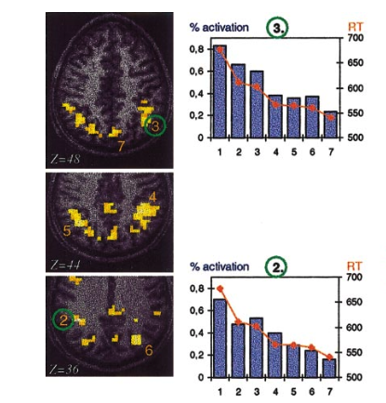
Symbolic Distance Effect
Memorize Number:
6
5
Less than
Greater than
Pinel et al. 2001 (Neuroimage)

Slide 11
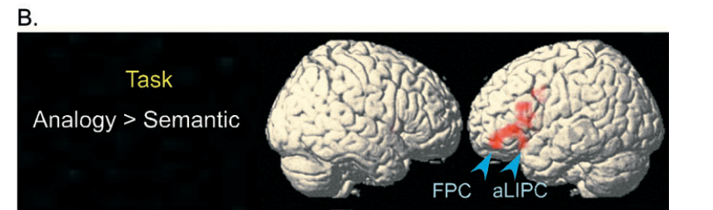
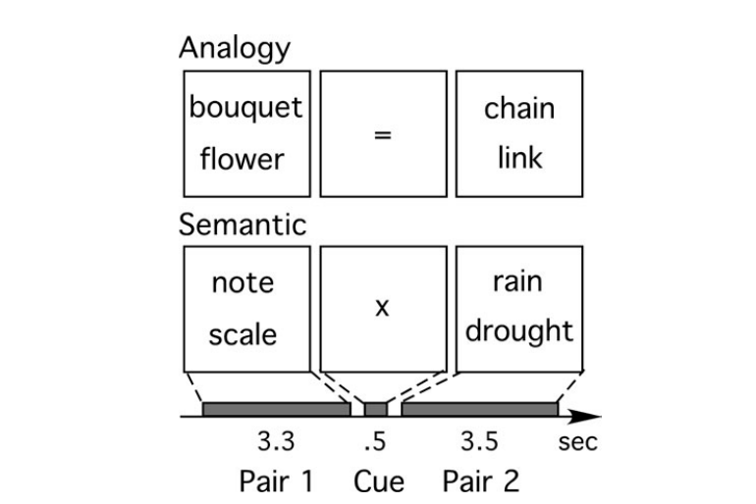
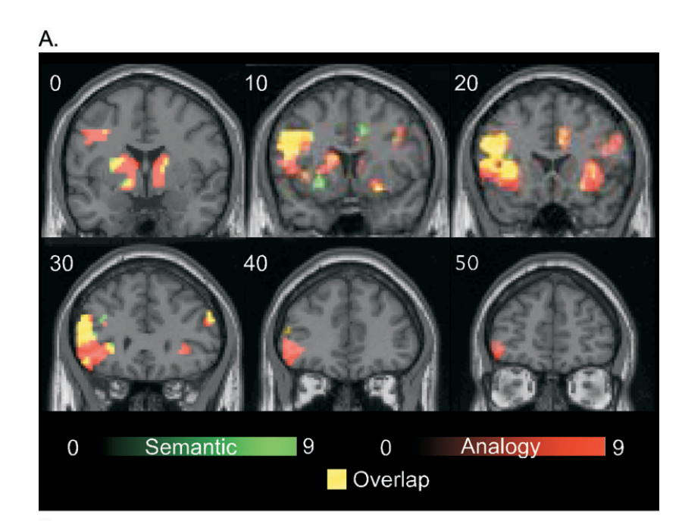
Analogy
(Bunge et al. 2005)

Slide 12
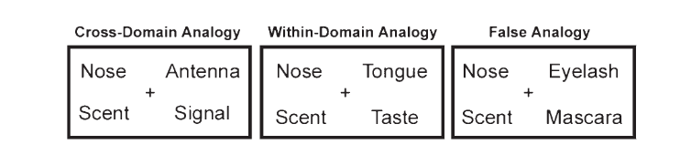
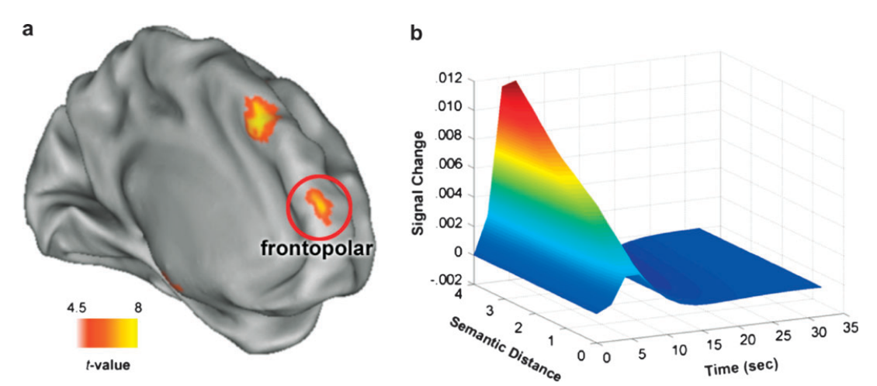
Semantic Distance Modulates Analogy-related activity
Green et al. 2010

Slide 13
Abstract Reasoning Corpus
Chollet, 2019
Notes:
The best AI in the competition could only solve 20.6% of the test-set problems.
This is like an “intelligence test” for AI…

Slide 14
Agenda: How Does a Brain Reason?
Types of Reasoning & Common Reasoning Tasks
Brief History of Intelligence Testing
Functional Brain Networks that Support Reasoning
My Research: Reasoning on a Simplified Raven’s Progressive Matrices Task

Slide 15
History: Intelligence Testing
Francis Galton (Darwin’s cousin) – Attempted to apply Darwin’s theory of evolution to the study of human abilities; coined the term “eugenics”
Alfred Binet & Theodore Simon – “Mental Age” hoped their tests would improve education, give children more opportunities
William Stern – Intelligence Quotient
Lewis Terman – promoted the widespread use of Intelligence Testing in the US during WWI, believed it would “curtail the reproduction of feeble-mindedness.”
Good TED Video about IQ tests: https://www.youtube.com/watch?v=W2bKaw2AJxs

Slide 16
Impact of Intelligence Tests
Between 1900 – 1950 intelligence tests were used to enforce the sterilization of approx. 60,000 people and the institutionalization of countless others. This continued as recently as the 1970s and largely target poor single women and racial minorities.
1950s and on: Herb Needleman pioneered the use of IQ testing to demonstrate the negative effects of lead poisoning. This led to government regulations on the use of harmful chemicals.
1971 Civil Rights Lawsuit (Larry P. v. Riles): A California judge ruled that IQ tests were “racially and culturally biased” and “discriminatory,” issuing a permanent ban on IQ testing of Black students in California
“It is not enough to have a good mind; the main thing is to use it well.” - Descartes
Radiolab Presents: G (6 – part podcast on the dark history of intelligence testing)
https://www.wnycstudios.org/podcasts/radiolab/projects/radiolab-presents-g
Notes:
“Based on the test results, black students statewide — young Darryl included — wound up categorized as “educable mentally retarded” at disproportionate rates: 27% labeled that way in 1968 were black — even though black students made up less than 9% of the student body.”
WAIS used to ask questions about who wrote Romeo & Juliet, or “What should you remember to bring with you on an airplane.”

Slide 17
Wason Selection Task (a role for context)
Which card(s) must you turn over to test the truth of the following proposition:
If a card shows an even number on one side, then its opposite face is red.
Notes:
Ansewr: 8 and Orange

Slide 18
Wason Selection Task (a role for context)
Which card(s) must you turn over to test the truth of the following proposition:
If you are drinking alcohol, then you must be at least 21 years old.
Notes:
16 and orange

Slide 19
Psychometric Theories of Intelligence
Two Factor (Spearman)
General Ability (G-factor); Specific Abilities (S-factor)
7 Domains of Intelligence (L.L. Thurstone)
Fluid vs. Crystallized Intelligence (Cattell)
8 Multiple Intelligences (Gardner)
3 Intelligences: Analytical, Creative, Practical (Sternberg)
Modern Tests: Wechsler Adult Intelligence Scale (WAIS), Wechsler Intelligence Scale for Children (WISC), Woodcock Johnson Exam, etc.

Slide 20
Biological Theories of Intelligence
Brain size (Wickett)
Brain Efficiency (Glucose Metabolism) (Haier)
Global Connectivity of PFC (Cole)
(Cole et al. 2012)

Slide 21
Parieto-Frontal Integration Theory (PFIT)
Brain regions w/ Broadman areas associated with better performance on measures of intelligence and reasoning
Analyzed Volumetric, Functional MRI, & PET evidence
(Jung & Haier 2007)

Slide 22
Agenda: How Does a Brain Reason?
Types of Reasoning & Common Reasoning Tasks
Brief History of Intelligence Testing
Functional Brain Networks that Support Reasoning
My Research: Reasoning on a Simplified Raven’s Progressive Matrices Task

Slide 23
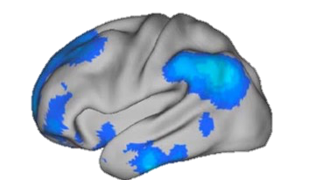
Functional Connectivity
How do spontaneous fluctuations in BOLD signal correlate between brain regions?

Slide 24
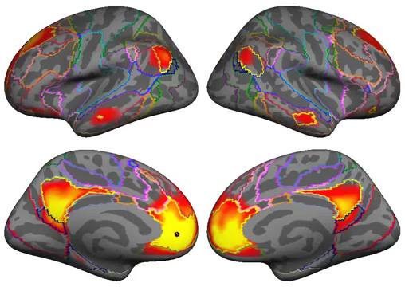
Functional Connectivity Networks
Yeo, et al. 2011

Slide 25
Resting State Networks
7-Network Parcellation
Yeo, et al. 2011 (J. Neurophys.)
Notes:
Yeo Networks, if needed

Slide 26
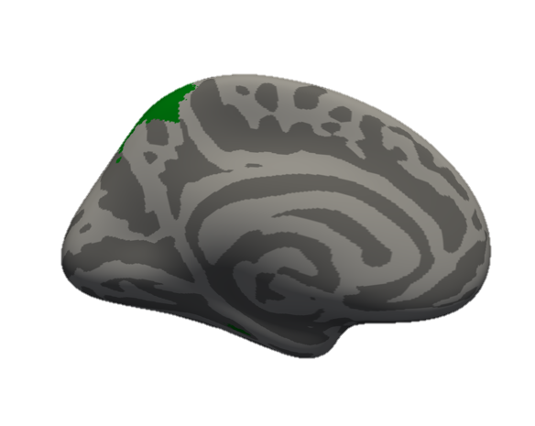
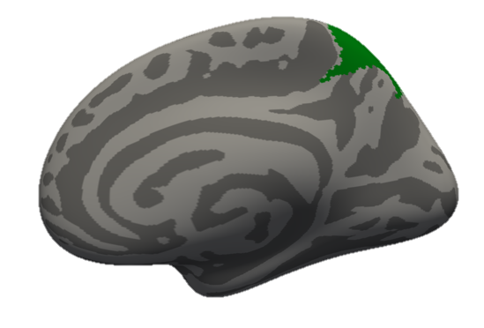
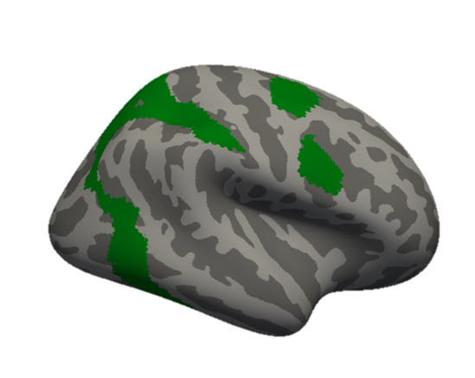
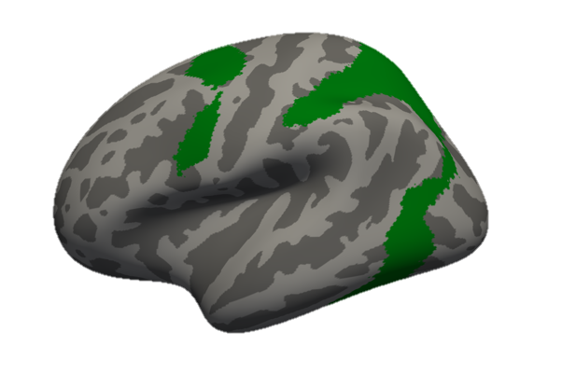
Dorsal Attention
Top-down directed attention
Attending to the external world
Multiple-object tracking, visuospatial attention/working-memory

Slide 27
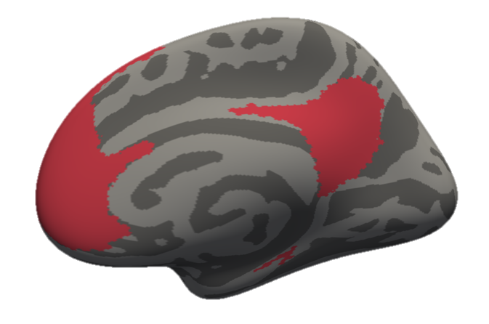
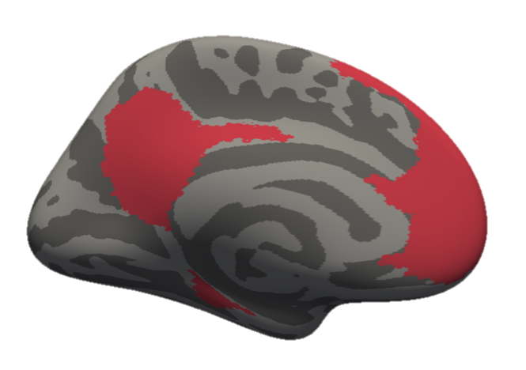
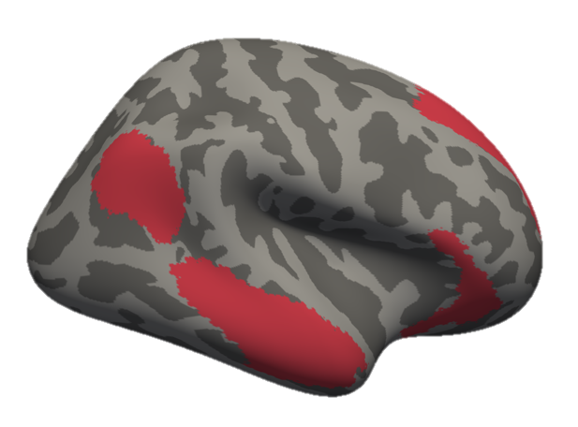
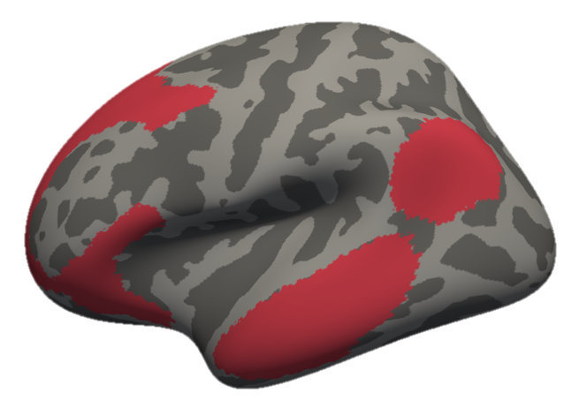
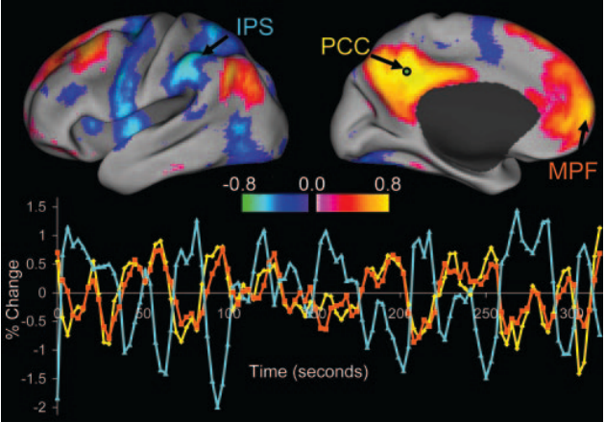
Default Mode
Introspection, imagination, memory
“Internal world”
Activated when subjects are “at rest”
Anti-correlated with Dorsal Attention Activity
Fox et al. 2005

Slide 28
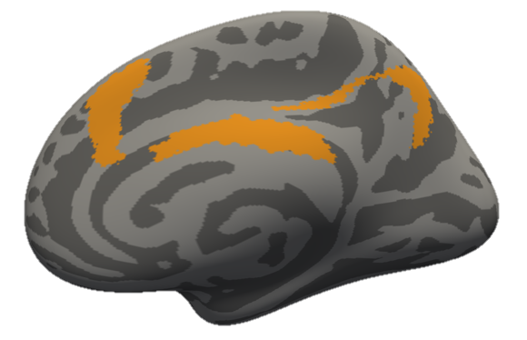
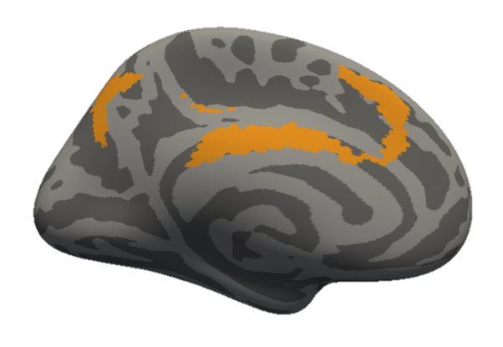
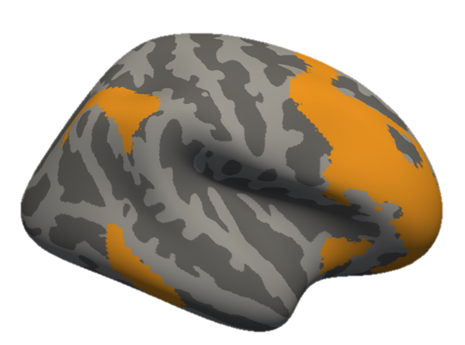
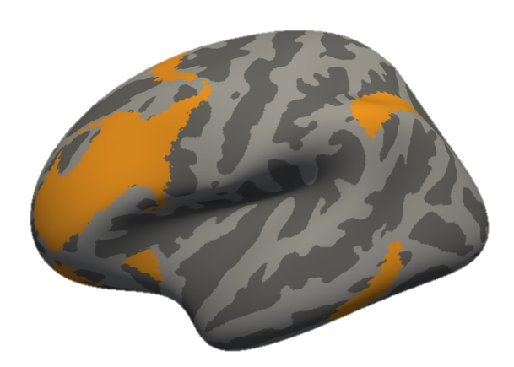
Frontoparietal Control
Cognitive Control, Executive function, response inhibition
Thought to regulate the anti-correlation of Default and Dorsal Attention Networks
(Cole et al. 2012)

Slide 29
Frontoparietal Activity Contributes to Relational Reasoning
Golde et al. 2010 (Neuroimage)
Genovesio, Wise, & Passingham; 2014 (TiCS)
Notes:
Instead of relationship: “rule”

Slide 30
Agenda: How Does a Brain Reason?
Types of Reasoning & Common Reasoning Tasks
Brief History of Intelligence Testing
Functional Brain Networks that Support Reasoning
My Research: Reasoning on a Simplified Raven’s Progressive Matrices Task

Slide 31
Matrix Reasoning (Raven’s Progressive Matrices)
Neuropsychological test of:
Fluid Intelligence
Relational Reasoning
Symbolic Processing
Two Main Problem Types:
Greenfield (2009)
Raudies & Hasselmo (2017)
Notes:
Matrix reasoning tasks have been used by neuropsychologists for almost a century to test fluid intelligence, relational reasoning, and symbolic processing.
Problem types range from simple picture completion problems (perceptual reasoning), to complex symbolic grid problems (symbolic reasoning).

Slide 32
Past Raven’s Studies
Golde et al. 2010 (NeuroImage)

Slide 33
Past Raven’s Studies
Melrose et al. 2007 (Brain)

Slide 34
Past Raven’s Studies
(R > Rc Condition)
Melrose et al. 2018 (Clinical Neuroimage)

Slide 35
Previous Work on the Raven’s Progressive Matrices Task
Computational Models
Carpenter, Just, & Shell (1990)
Kunda, McGreggor, & Goel (2013)
Rasmussen & Eliasmith (2011, 2014)
Lovett & Forbus (2017)
Raudies & Hasselmo (2017)
Hasselmo (Preprint, 2018)
fMRI Studies
Prabhakaran et al (1997)
Christoff et al. (2001)
Melrose, Poulin, & Stern (2007)
Golde, Cramon, & Schubotz (2010)
Greenfield (2009)
Raudies & Hasselmo (2017)
Notes:
There have been many previous studies that have tried to either model the Raven’s matrices or look for the neural signals that underlie successful performance on the task. Still, most of this research has focused on the symbolic version of the task.
In our experiment, we wanted to also examine the perceptual reasoning condition. Do these two conditions draw on the same brain regions? Are they even testing the same skill? This work has implications for neuropsych testing, for computational modelling (should these two tasks be modelled the same way?), and ultimately for artificial intelligence (how should we design a system to flexibly solve both tasks?)

Slide 36

Abstract reasoning is an essential basic feature of human cognition
Exit 1
Exit 2
Exit 3
???
Notes:
Humans have a unique ability to quickly solve new problems using abstract reasoning.
One example of reasoning behavior that you’ve probably all experienced is when you’re driving down the highway looking for your exit.
You see Exit 1 go by, followed by Exit 2, and you know to expect Exit 3 next.
(Note: Car/Exit signs are animated)

Slide 37
Proposed Components of Abstract Reasoning
2
1
Symbolic Processing: Convert complex visual information into simplified symbolic ideas containing only the essential information
Analogical Thinking: Determine how the symbols change and relate to each other. Predict what comes next.
3
Exit 1
Exit 1
Exit 2
Exit ?
Notes:
When you’re looking at exit signs, there are a few things going on:
First, we believe that the brain creating symbolic representations of the road signs, condensing all of the complex visual information into only the most essential features (e.g. the number 1, 2, or 3)
Second, the different symbols are compared to each other and a rule representation is created using analogical thinking. This rule allows the brain to extrapolate and determine what comes next.

Slide 38
Motivation
Question:
Does the frontoparietal cortex equally contribute to perceptual reasoning and symbolic reasoning?
Hypothesis:
Both types of reasoning recruit frontoparietal regions.
Specialized regions will support symbolic and perceptual reasoning.

Slide 39
Task Conditions
Perceptual Control
Perceptual Reasoning
Symbolic Control
Symbolic Reasoning
Notes:
Here is the task we have designed for the MRI scanner. Participants see a pattern at the top of the screen, and must select which of the two answer choices below best fits into the blank white square. We were most interested in the symbolic reasoning and perceptual reasoning conditions. Tight controls were designed to account for vision, attention, and working memory. Also, we extensively piloted the task to ensure that response times were matched across conditions.

Slide 40
Sample Trial
N=27
396 Trials per Participant
Notes:
Participants saw each stimulus for 4s. They were given 1 second of feedback (Correct, Incorrect, or No Response). ITI ranged from 0.5-3.5 (jittered). Our final results include data from 27 participants. Only correct trials were included in the general linear model.

Slide 41
Activity During Symbolic and Perceptual Reasoning
Symbolic
Reasoning
>
Symbolic
Control
Perceptual
Reasoning
>
Perceptual
Control
Notes:
Cortical regions circled in red are activated for one condition, but not the other. (This is confirmed by an interaction analysis)

Slide 42
Yeo-7 Network ROI Analysis
Perceptual Reasoning > Perceptual Control
Symbolic Reasoning > Symbolic Control
Notes:
Next, we wanted to know which cortical networks were activated during the conditions of the task. As a visuospatial reasoning task, we saw expected increases in the visual (purple) and dorsal attention (green) networks. We also saw increased activity in the frontoparietal control network (orange), but this increase was significantly greater for symbolic compared to perceptual reasoning. Activity in the FPCN is associated with executive control, working memory, and is sometimes called the multiple-demand network.

Slide 43
Conclusions
Frontoparietal regions contribute to both symbolic and perceptual reasoning, but the FPCN is more strongly activated by symbolic reasoning.
Perceptual and symbolic reasoning should not be considered common tasks, and should probably be modelled separately in computational systems.

Slide 44
Acknowledgements
Stern Lab
Chantal Stern
Matt Dunne
Stamati Liapis
Kylie Moore
Caroline Ahn
Kylie Isenburg
Kelli Tahaney
Tashauna Blankenship
Cognitive Neuroimaging Center
Stephanie McMaines
Shruthi Chakrapani
Funding
NSF Major Research Instrumentation Award 1625552
ONR MURI Award N00014-16-1-2832
ONR DURIP Award N00014-17-1-2304

Slide 45
Frontoparietal Activity Contributes to Abstract Reasoning
Common Modelling Approach:
Deduce the visuospatial relationship between stimuli (Parietal)
Apply that rule to simulate what comes next (Prefrontal)
Golde et al. 2010
Genovesio, Wise, & Passingham; 2014
Notes:
We know from previous work that frontoparietal cortex contributes to resoning. In this review from Genovesio, reduced volume in PFC and PPC is associated with reduced scores in fluid intelligence. Golde and colleagues show increased activity of frontoparietal cortex in abstract reasoning problems that require the integration of multiple rules.

Slide 46
Computational Models of the Raven’s Progressive Matrices
Common Modelling Approach:
Deduce the visuospatial relationship between stimuli
Apply that rule to simulate what comes next

Slide 47
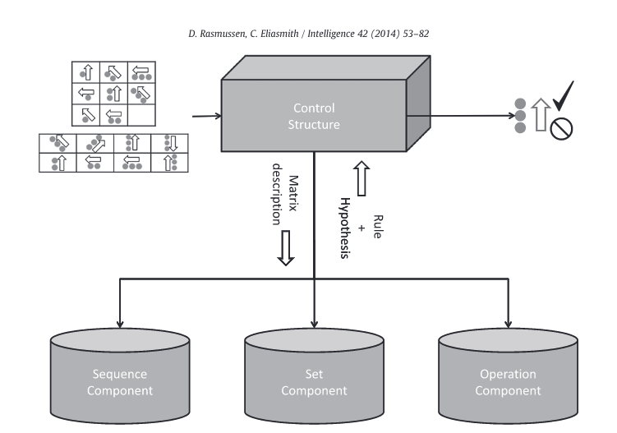
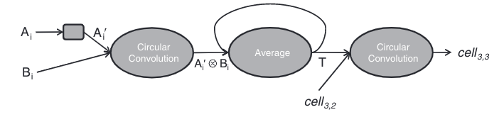
Computational Models of the Raven’s Progressive Matrices Task
Sequence Component:
Deduce Relationship
Apply
Relationship
Rasmussen & Eliasmith, 2014 (Intelligence)

Slide 48
Computational Models of the Raven’s Progressive Matrices Task
Deduce
Relationship
Apply
Relationship
Define Stimulus Features
Raudies & Hasselmo, 2017 (Bio. Insp. Cog. Arch.)

Slide 49
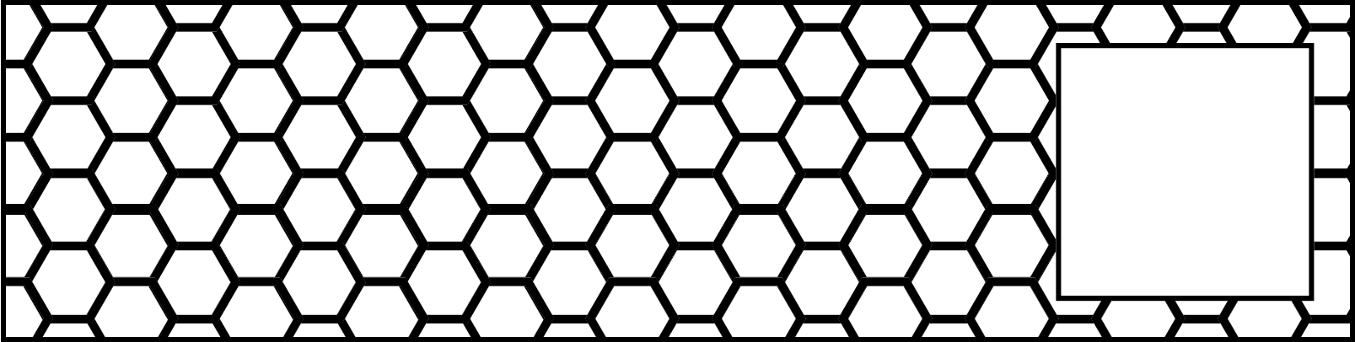
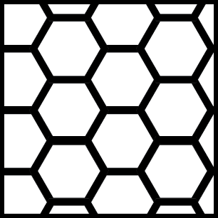
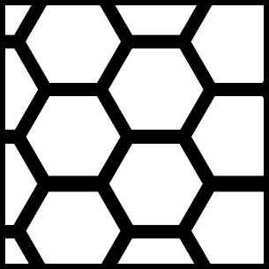

Slide 50




Slide 51
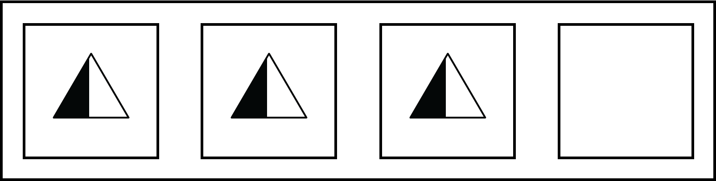



Slide 52



Slide 53
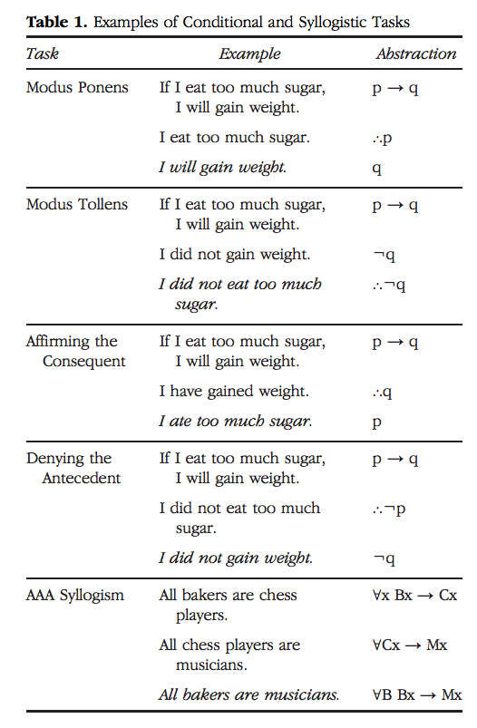
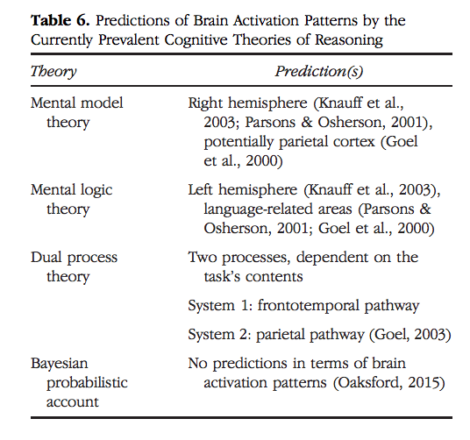
Syllogisms
Wertheim & Ragni 2020

Slide 54
Spatial Reasoning (Mental Rotation)
Mental Rotation Task (Shepherd & Metzler 1971)
Gogos et al. 2010

Slide 55
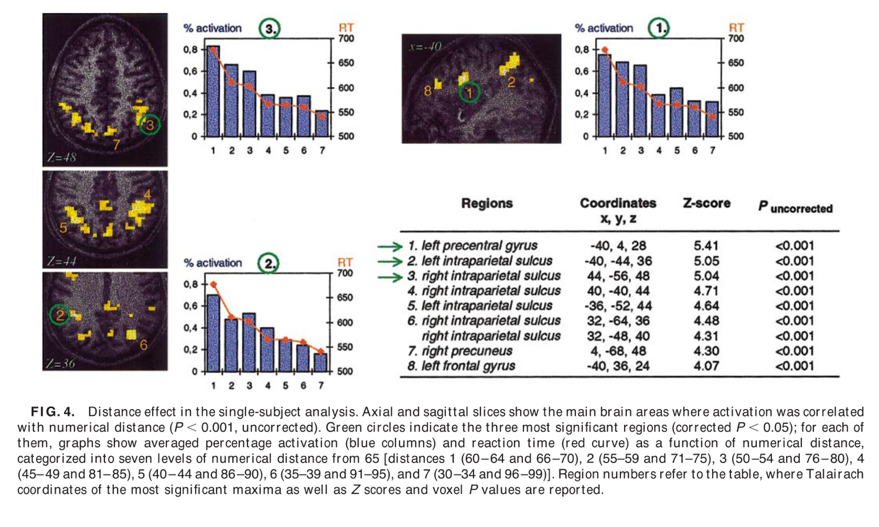
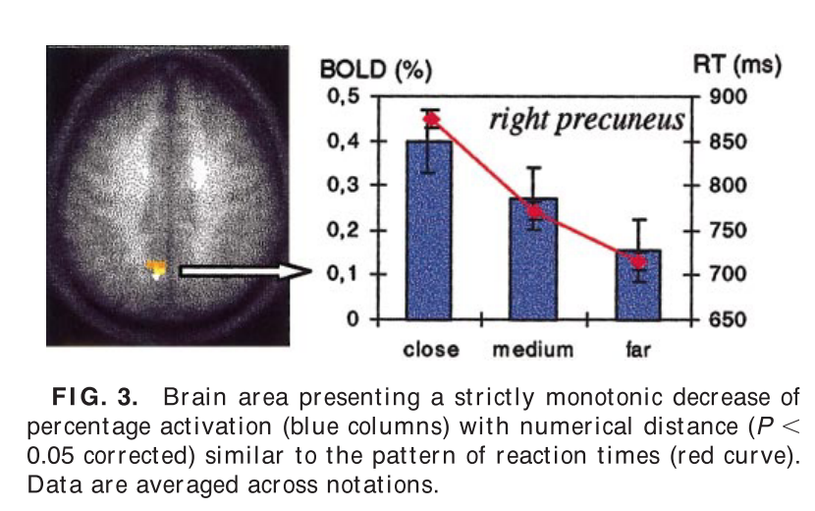
Semantic Distance Effect
Pinel et al. 2001
Decide if a number is bigger or smaller than a previously memorized number (65)

